Slide 1
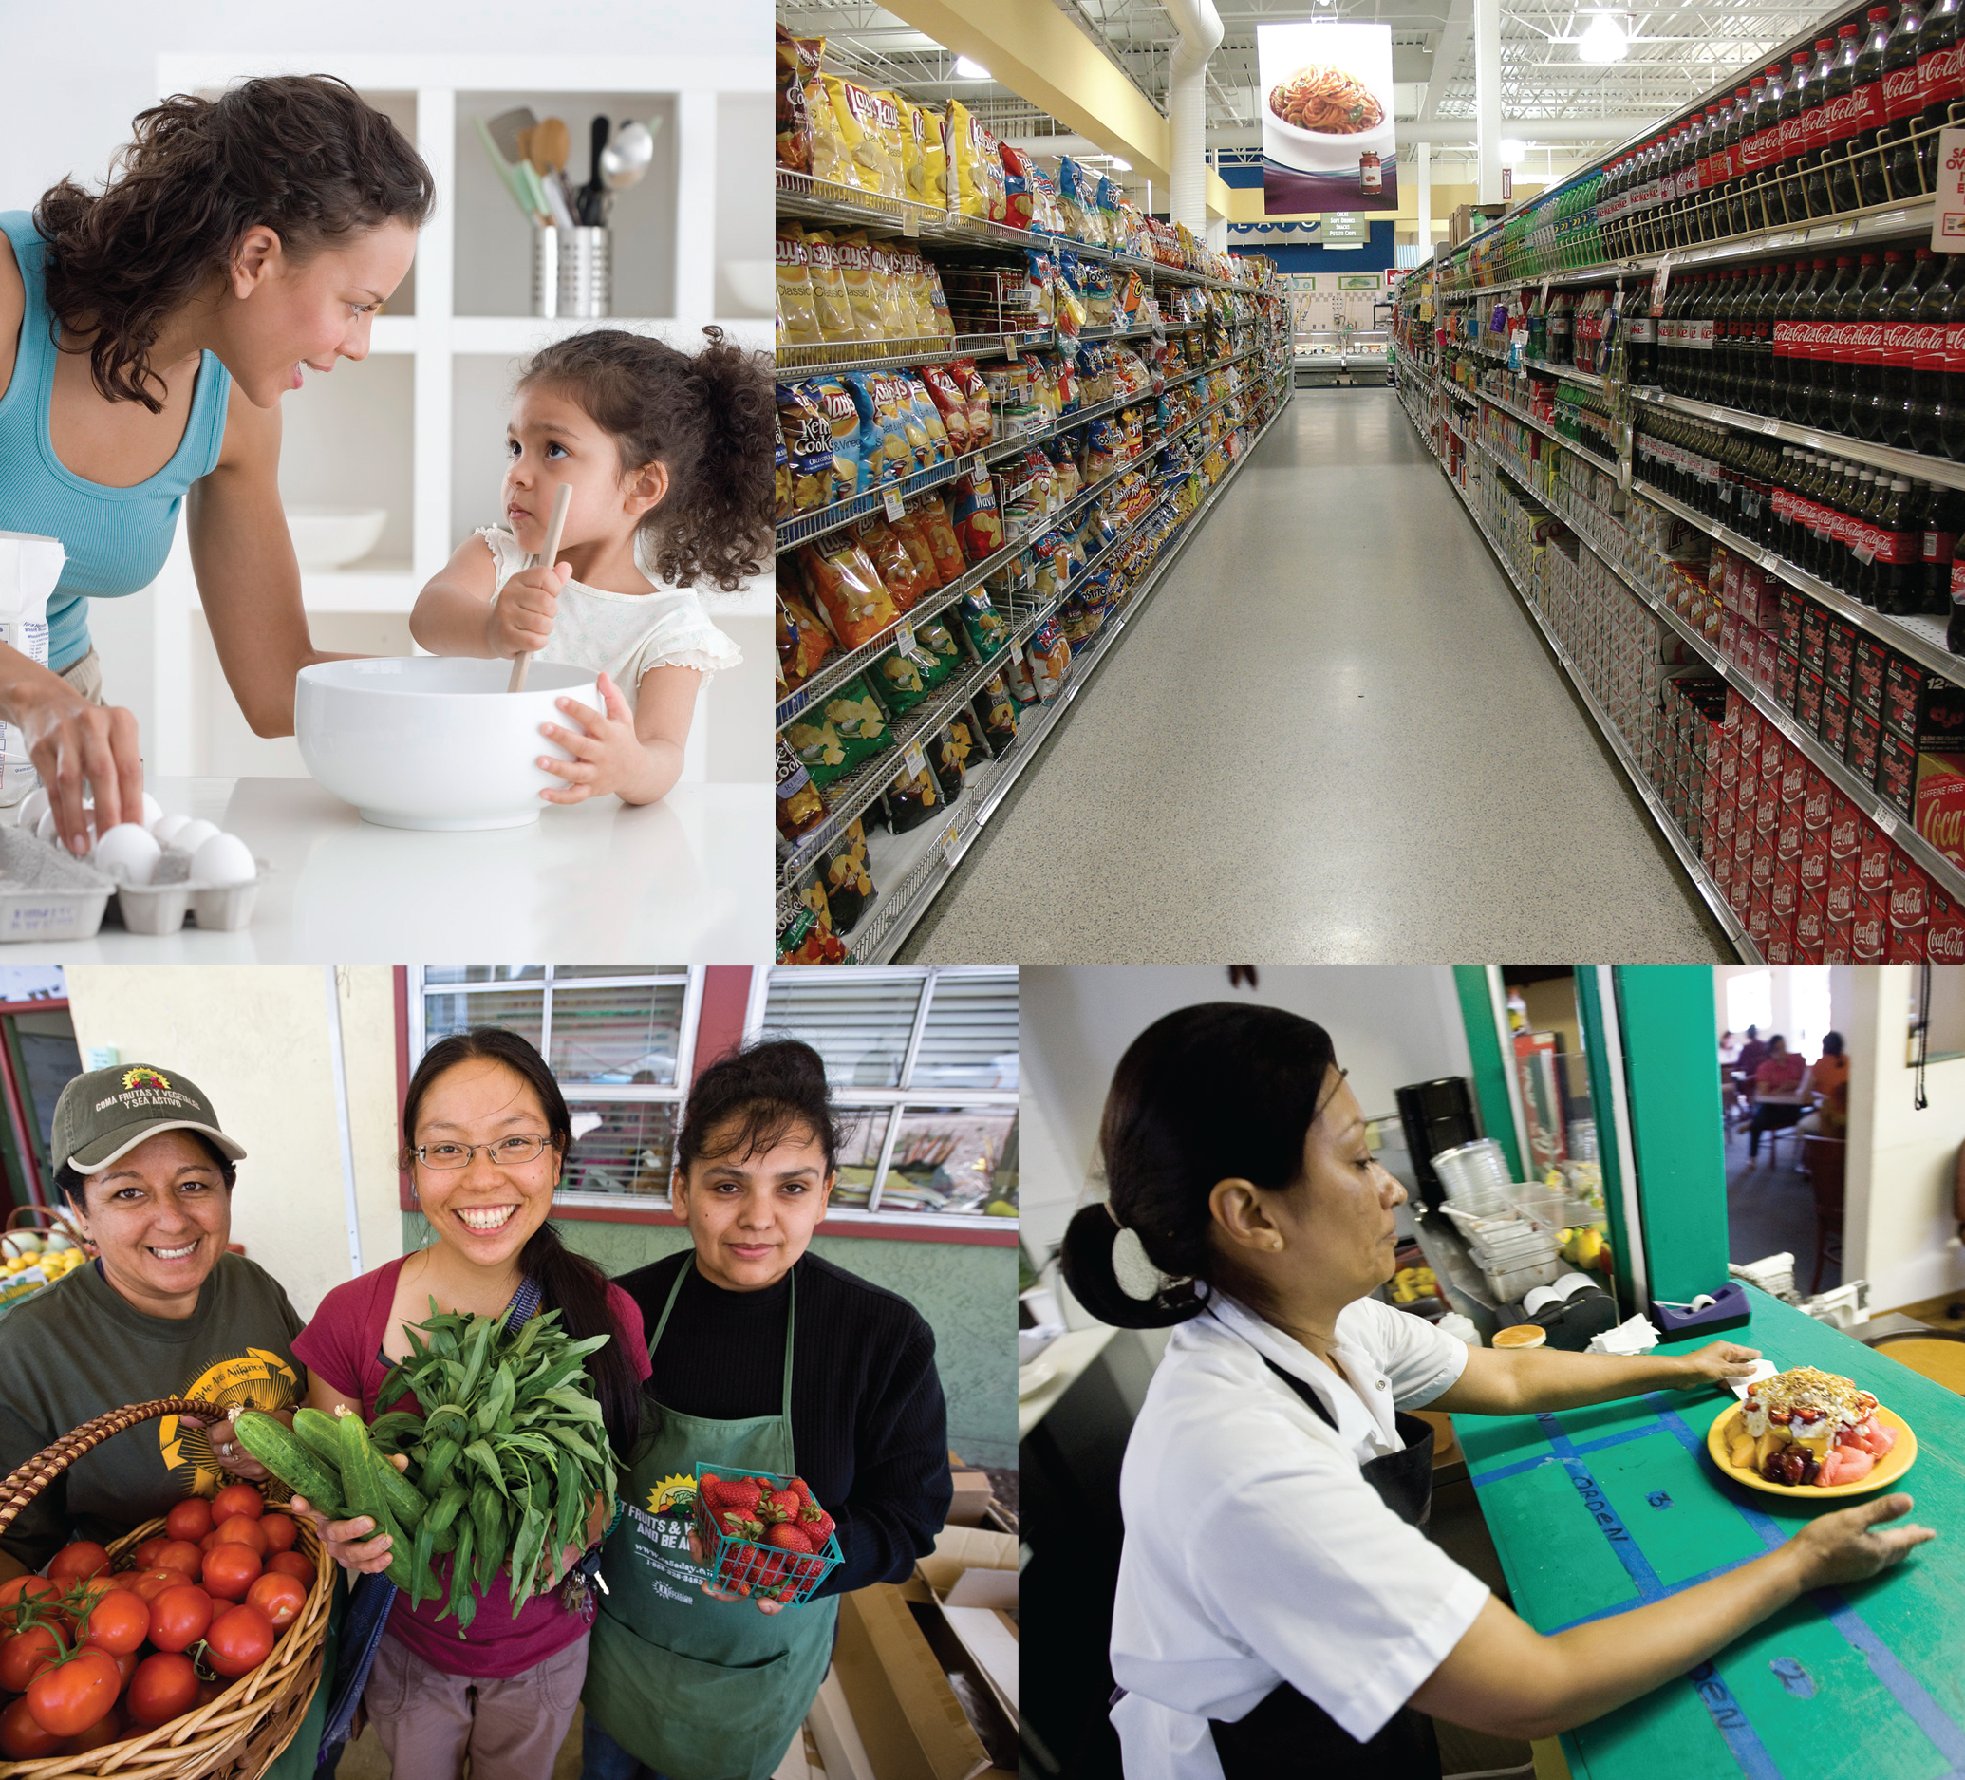
Resident Leadership Academy
SESSION FIVE
HEALTHY FOOD
SYSTEMS

Slide 2
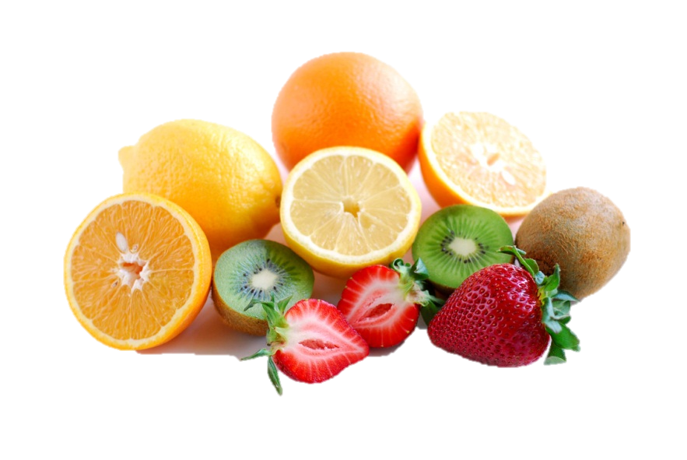
AGENDA
agenda
Session 5
Healthy Food Systems
Session Objectives:
1. To explore the components of food systems
2. To understand the factors that lead to unhealthy eating
3. To identify strategies to increase access to sources of healthy, locally produced food
Welcome/Review
“Hungry for Change” Video/Discussion
Food Systems Presentation
Unhealthy Eating Factors
Healthy Eating Options
Conclusion
2

Slide 3
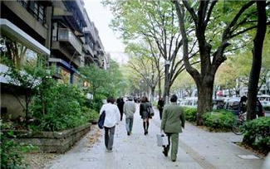
SESSION REVIEW
Safe, Walkable Communities & CPTED Session
Homework activity -Neighborhood Assessments with pictures
Things you remember from session 4
Questions/Comments
3

Slide 4
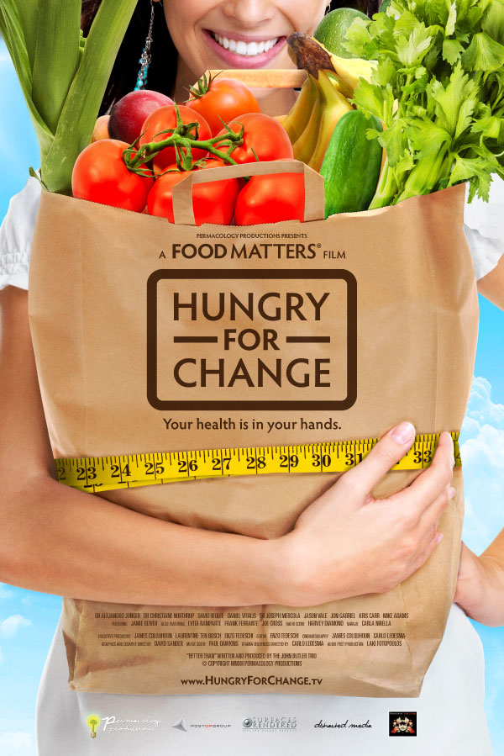
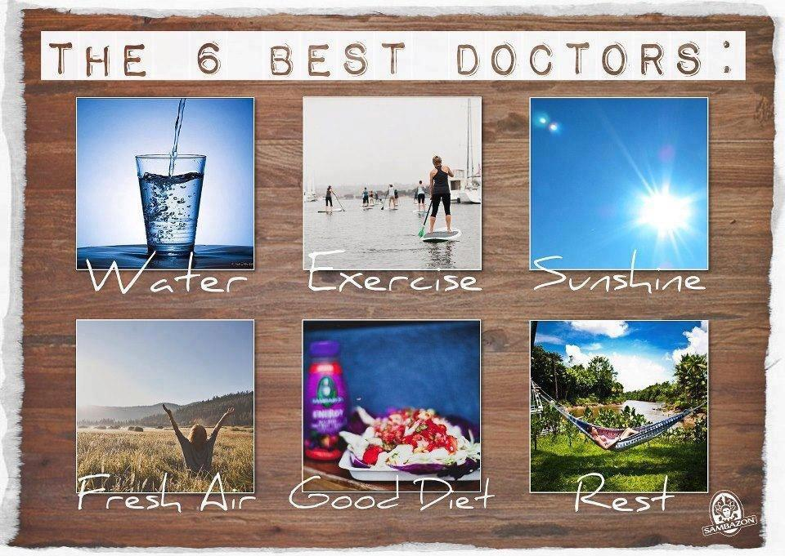
FOOD MATTERS
Linda Cornejo
Ilya Uribe
Rose Mary Ramirez
Rosa Alcarez
Donna Williams
Hungry For Change Official Home Page - A Food Matters Film
Notes:
We’ll watch a few videos on food systems and the connection to health.
[Link: http://www.hungryforchange.tv/ ]

Slide 5
5
Notes:
What are things you can do to create healthy food systems?
[Ask RLA members first, then supplement with ideas from below]
Drink fewer sodas and other sweetened beverages
Eat at home instead of eating out
Ask your local restaurants to post calories of menu items in a prominent place so it’s easy for people to find
Tell schools to stop selling sodas,
junk food, and sports drinks
Enjoy meatless Mondays
Buy organic foods
Protect family farms
Know where your food comes from
Tell Congress that food safety
is important
Demand job protections for
farm workers and processors

Slide 6
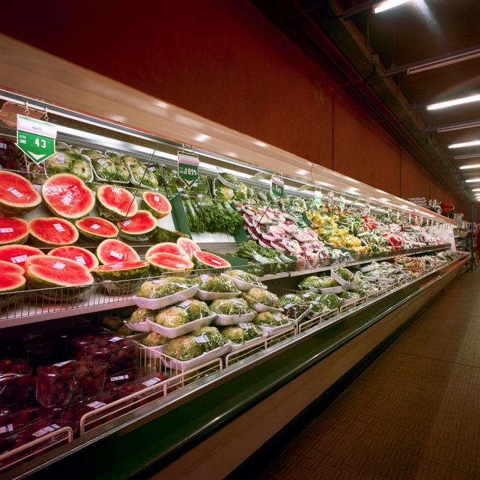
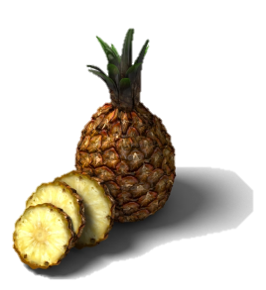
What does a Food System consist of?
FOOD SYSTEMS
Growing
Harvesting
Processing
Packaging
Transportation
Marketing
Consumption
Disposal
Food System
WHAT DOES A FOOD SYSTEM CONSIST OF?
6
Notes:
In our current food system, between where your food is grown and when it is on your dinner table, there is a long chain of processes that take place.
[Walk through chain from growing to disposal: growing, harvesting, processing, packaging, transporting, marketing, consumption, and disposal of food and food-related items.]
The chain also includes what is put into a system or expended in its operation to achieve results.
A food system includes all processes and infrastructure involved in feeding a population: growing, harvesting, processing, packaging, transporting, marketing, consumption, and disposal of food and food-related items.
A food system operates within social, political, economic and environmental contexts.
It also requires human resources to provide labor, research, business processes, financial management, and education.
This diagram shows a conventional food system. What could an alternative food system look like?
For immigrant and refugee communities:
State that this is how the food system is in the US. You could ask how it may have differed/ which steps may have been taken out where they are from.

Slide 7
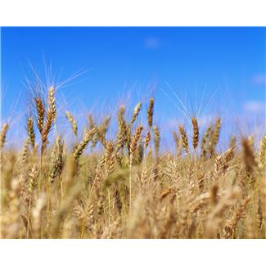
TYPES OF FOOD SYSTEMS
Alternative
Conventional
Involves widespread distribution, according to cost
Driven by expansion and increasing profits
Based on a productivity model
Industrial Food Systems
Multi-national Corporations
Locally-focused to provide direct benefit to communities
Geographically and economically accessible
Seasonal, native, sustainable
Local Food System
Community Food System
Organic Food System
7
Notes:
There are two types of food systems: conventional and alternative.
For immigrant and refugee communities:
Discuss how the US is a conventional food system (maximizing production). Ask which type they think their country of origin is.

Slide 8
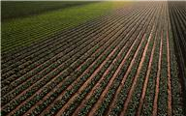
Food Systems
Influenced by
Social
Environment
Political
Economic
FOOD SYSTEMS
It also requires human resources to provide labor, research and education. Food systems are either conventional or alternative according to their model of food lifespan from its origin to the plate.
8
Notes:
A food system is influenced by social, political, economic and environmental contexts. Food systems influence many different aspects of our lives:
Community Economic Development
How does a community’s economy affect food?
Food
What determines what you eat?
Health
How does food affect your health?
Agriculture
What determines where your food is grown?
Nutrition
What food is healthier for you?

Slide 9
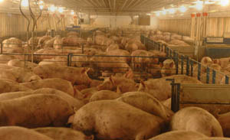
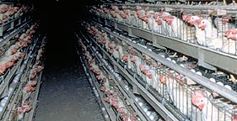
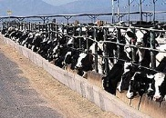
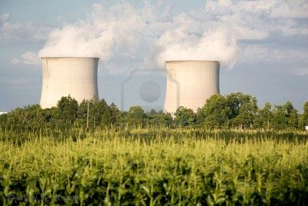
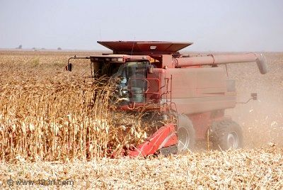
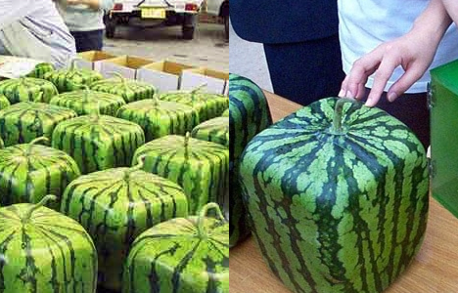
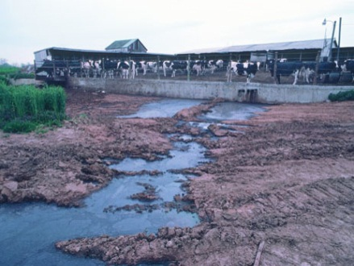
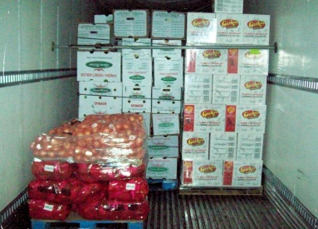
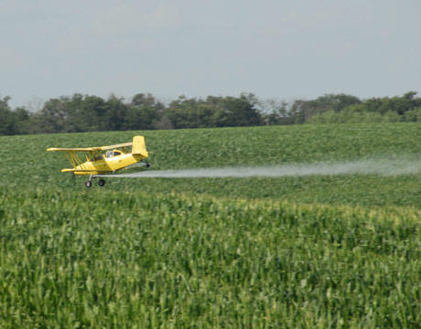
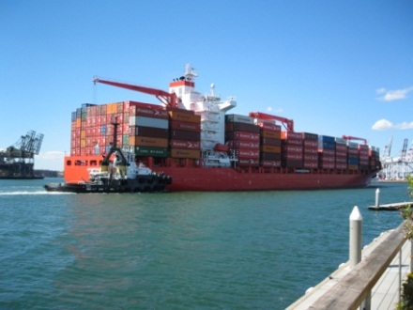
what can u.s. farms tell us about our food system?
9
Notes:
Food is grown in our conventional food system to maximize production and transportation of food, not for quality and taste. If there is a food safety outbreak, it can affect multiple states, not just one farm, because food is grown in mass quantities and transported across the country.

Slide 10
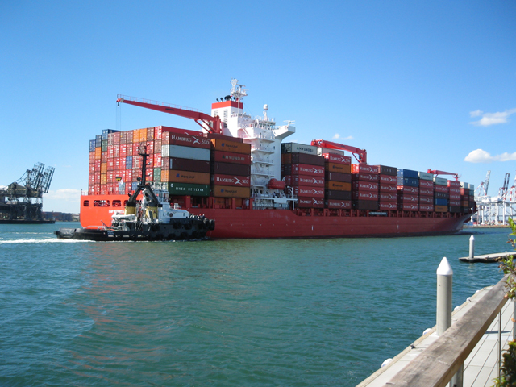
environmental impacts
Harmful chemicals (pesticides & fertilizers)
Industrial scale farming
Contaminated run-off
10
Notes:
Our conventional food systems also damage our environment. Industrial-scale farming with one crop saps the soil of nutrients. The use of pesticides and fertilizes to maximize volume means that those chemicals contaminate the ground and water supply. The chemicals also run into streams and rivers and harm wildlife.
The Mississippi River is so contaminated from farm and industrial run-off that when the River enters the Gulf of Mexico it’s called the “Dead Zone” because no plants or marine animals can survive. The area is up to 7,000 square miles, which is the same as 6 Yosemite National Parks (1,170 square miles)

Slide 11
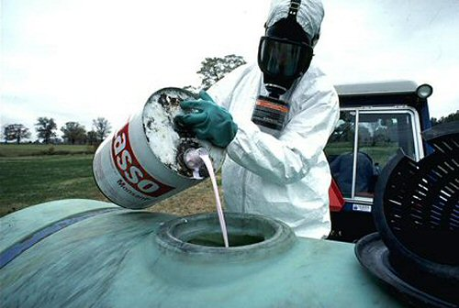
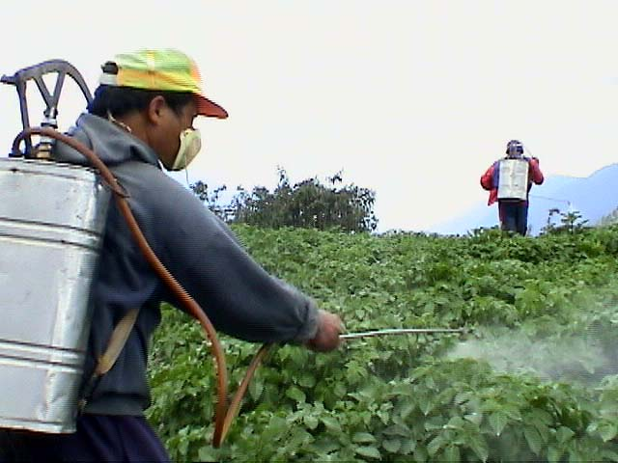
farm workers
Work with toxic chemicals that harm their health
The average worker is paid 20% less today than they were in 1985
11
Notes:
The chemicals and pesticides on a farm also harm farm workers. Farm workers work long hours in often very hot conditions, and are exposed to toxic chemicals. Long-term exposure to these chemicals can have serious health consequences.

Slide 12
ANIMAL MISTREATMENT
12
Notes:
Intensive farming techniques called ‘factory farming” restrict animals grow for food to tight spaces to maximize production.
Factory farms often have low level of animal welfare standards /conditions, which leads to pollution, health issues, E.Coli outbreaks, etc.

Slide 13
what farms & pantries can tell us
about food systems around the world
WHAT DO OUR PANTRIES TELL US ABOUT OUR HEALTH?
United States
13
Notes:
What are the differences between the types of food found in the U.S. versus the home pantries of other countries?
What do you think this means about their food system? What do you think you would see in the grocery store?

Slide 14
what farms & pantries can tell us
about food systems around the world
Italy
Free Range Farming
Pantry
14
Notes:
Ask people what they notice in the slides about the farms and what the families eat.
What do you think this means about their food system? What do you think you would see in the grocery store?

Slide 15
what farms & pantries can tell us
about food systems around the world
Japan
City Farming
Pantry
15
Notes:
Ask people what they notice in the slides about the farms and what the families eat.
What do you think this means about their food system? What do you think you would see in the grocery store?

Slide 16
what farms & pantries can tell us
about food systems around the world
Ecuador
Seasonal Farming
Pantry
C
16
Notes:
Ask people what they notice in the slides about the farms and what the families eat.
What do you think this means about their food system? What do you think you would see in the grocery store?

Slide 17
what farms & pantries can tell us
about food systems around the world
Bhutan
Rice Farm
Pantry
17
Notes:
Ask people what they notice in the slides about the farms and what the families eat.
What do you think this means about their food system? What do you think you would see in the grocery store?

Slide 18
what farms & pantries can tell us
about food systems around the world
Mexico
Farm
Pantry
18
Notes:
Ask people what they notice in the slides about the farms and what the families eat.
May point out balance between fruits and vegetables, and soda in the back.
What do you think this means about their food system? What do you think you would see in the grocery store?

Slide 19
what farms & pantries can tell us
about food systems around the world
Egypt
Farming Melons
Pantry
19
Notes:
Ask people what they notice in the slides about the farms and what the families eat.
What do you think this means about their food system? What do you think you would see in the grocery store?

Slide 20
FOOD SYSTEMS
Global Conventional
Globalization of our food system is affecting health negatively at a global scale
Regional
Most of the food we buy at our local supermarket has traveled very far to get there
Local Alternative
Is a better option for our health, local economy, the environment, and communities
20
Notes:
Buying local foods is a better option for our health, local economy, the environment, and our communites.

Slide 21
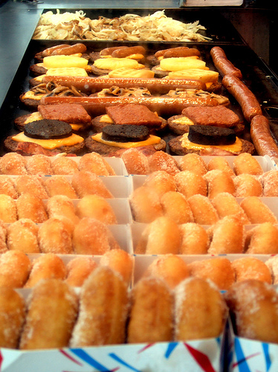
UNHEALTHY EATING FACTORS
21
Notes:
Often times food policy influences the food that we eat. Corn crops are heavily subsidized in our country, which means that food producers like to use corn and corn oil to make their products because they can make a large profit.
While fast food and processed food are very inexpensive to purchase, their true cost is much higher. The impact on our health, damage to the environment, harms to farm workers and other costs to our society and planet are not included in the price of the food.

Slide 22
UNHEALTHY CONSEQUENCES
Short-term
Long-term
Feeling easily tired, highs and lows in energy levels, especially for those with diabetes
Lost concentration
Unhealthy weight gain
Allergic reactions
Chronic disease, including diabetes and heart disease
Reduced quality of life
Reduced life span
Poor dental health and high dental care costs
22
Notes:
How do you feel after you eat fast food, desserts, or processed foods?
What are the other health consequences of a poor diet?
For immigrant and refugee communities:
Possibly ask how they talk to their children about fast food, processed food, or eating vegetables. Oftentimes, recent arrivals to the U.S. are healthier than their U.S. counterparts because they bring healthy food culture with them from their home country. Can also ask how they promote their favorite cultural food within their family if their children are mostly growing up in the U.S.
Please note that most recent arrivals to the U.S. have better health because they bring their food customs with them, which are usually healthier than the US. It’s the second and third generations that usually have similar health patterns to the U.S. Almost all countries have many fast food outlets now, but often times these outlets are expensive or considered a meals for special occasions. Could ask how adult refugees talk with their children about limiting unhealthy foods in a country flooded with high-fat meat, lots of pre-packaged and processed foods, and fewer vegetables.
As more generations grow up here, they might also lose the knowledge of how to cook and prepare typical meals from their country, therefore losing part of their culture.

Slide 23
MARKETING
23
Notes:
Test your logo knowledge test of the fast food locations in the picture. How many brands do you recognize?
Food manufacturers use marketing so that consumers feel familiar with their products and recognize the brand and products. Most kids know the McDonalds jingle even at a very young age. Aggressive and pervasive marketing creates brand loyalty to products.
Success based on aggressive marketing strategies, including online advertising through games and kid-friendly websites. Coca-Cola and McDonalds often receives free marketing by selling their products in vending machines and in school or college cafeterias. It’s common to see large Coca-Cola or other advertisements and banner at sporting events.
Unhealthy food chains become predominant in neighborhoods through prominent signs, logos, billboards & advertisements

Slide 24
where does your dollar go?
24
Notes:
The cost of production and distribution of food is minimal compared to the cost of marketing products. Consumers are paying more for advertising, transportation, and packaging than for the actual food. What does this say about the quality of the foods we consume?

Slide 25
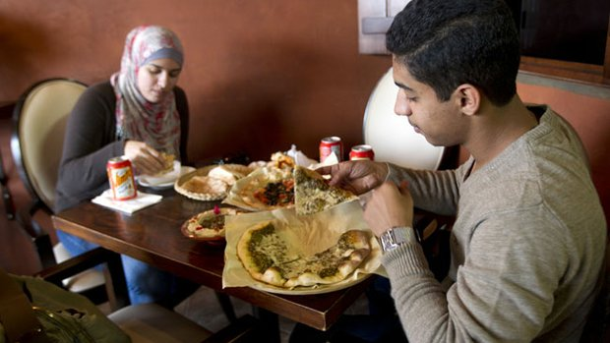
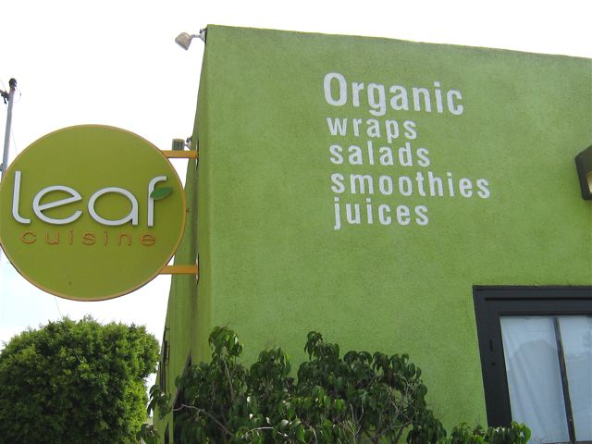
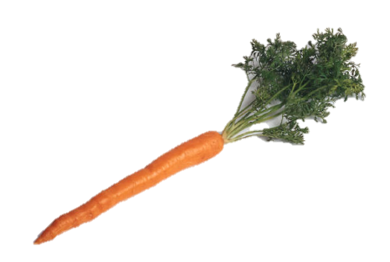
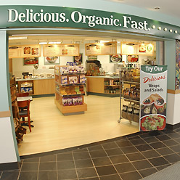
HEALTHY EATING OPTIONS
San Diego, CA
Increase in healthy restaurants and items
Los Angeles, CA
Berkley, CA
25
Notes:
There are several ways of making sure that healthy food options are available in your community:
Farmer’s Market
Community Gardens
Community Supported Agriculture (CSA)
Increase in healthy food menu items offered in restaurants
What are some healthy restaurants in your community?

Slide 26
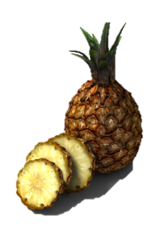
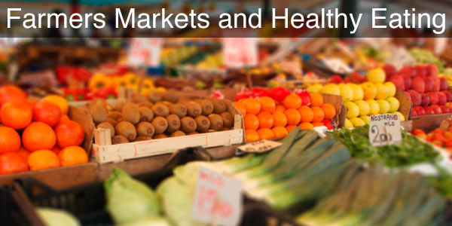
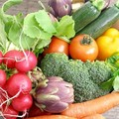
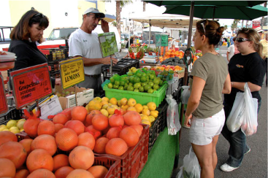
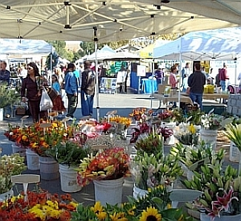
HEALTHY EATING OPTIONS
Oceanside, CA
Farmer’s Market
Temecula, CA
San Diego, CA
El Cajon
26
Notes:
There are a variety of benefits to farmers market:
They support local farmers and economies, because the sellers are from San Diego. Working with local farmers means that you can ask questions about where your food is coming from and how is it grown. It also means that your dollars support small, local businesses, which keeps dollars in the communities where we live.
There is less waste because food that is sold is grown locally, and does not have be shipped across the country or around the world, which reduces pollution from shipping.
Some Farmers Markets accept EBT (Food stamps) and WIC.
Farmers Markets also bring communities together: neighbors can meet their neighbors, meet their local farmers, and it’s a regular place for social interaction.
Have you been to your local farmers market? (If you are interested in visiting your local farmers market, there is a list of markets at www.sdfarmbureau.org)
*Intergenerational (IG): Access to healthy eating options may be challenging for some seniors, as it lack of transportation and having a limited and fixed income may serve as obstacles

Slide 27
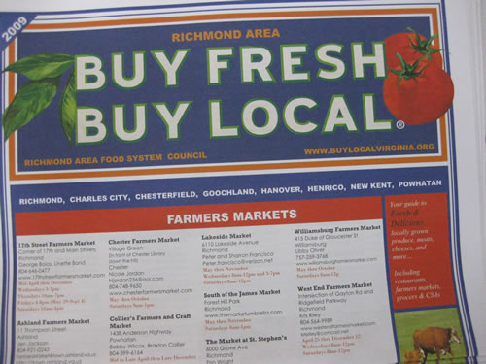
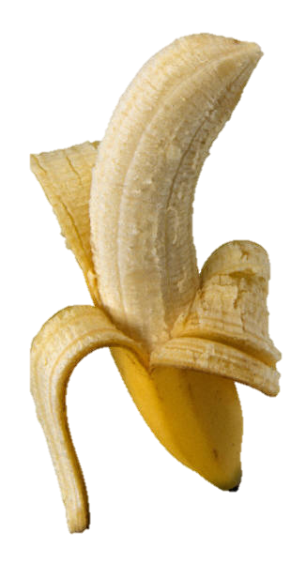
Seasonal produce is often food that gives each region its distinct culture
27
Notes:
Farmers markets and CSAs also take advantage of seasonal produce – the fruits and vegetables are harvested and sold based on what’s in season. Farmers markets help grow a culture of preparing food that is in season and appreciating the variety of produce and our season.
Instead of eating watermelons in the winter, farmers markets sell water melons in the summer when they are the freshest and most delicious. We are used to having watermelon whenever we want it, so this is a change for many of us.

Slide 28
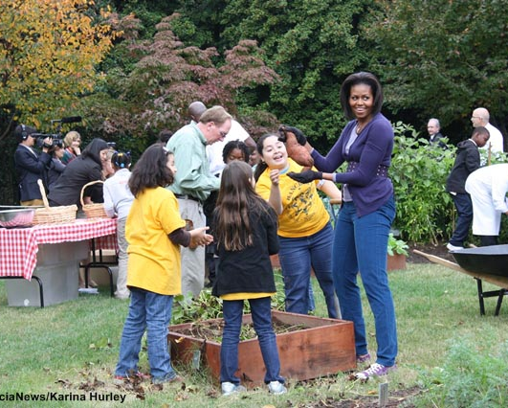
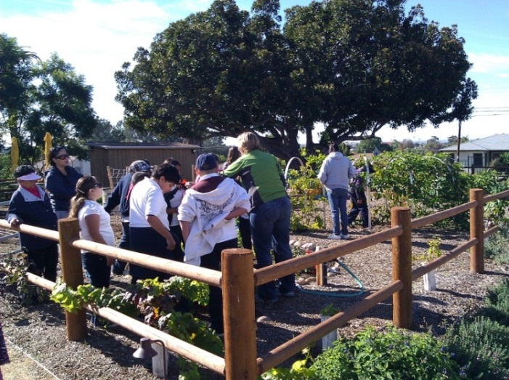
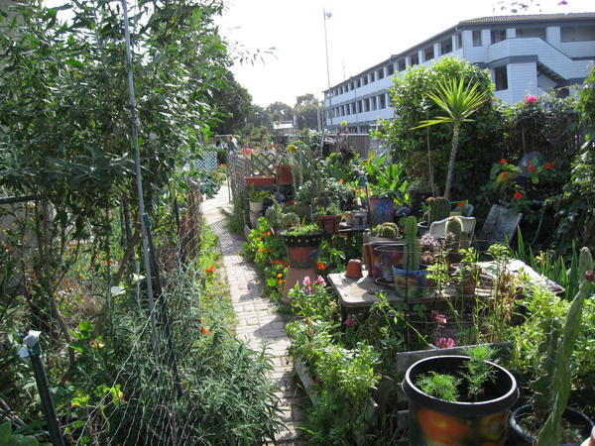
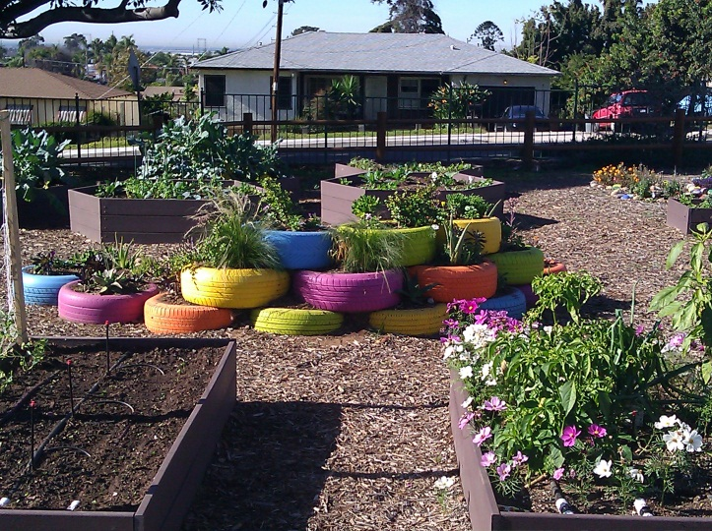
HEALTHY EATING OPTIONS
Community Gardens
San Diego, CA
National City, CA
28
Notes:
Community gardens are a resource for individuals and families that want to grow their own food. Like farmers market, they are a community space that brings people together of all ages. For some families, it can help reduce their food costs. Depending on the local ordinance for community gardens, some gardeners are able to sell the produce they grow at their local farmers market, or donate their extra food to a food bank.
Gardens can also be a space for people to grow herbs, fruits, and vegetables used in their culture that may be difficult to find at your average supermarket. For instance, purila is a common herb used in Vietnamese food that could be grown in a garden so that a Vietnamese family could include it their meals. The family could also share their culture’s food with community members from other cultures.
*Intergenerational (IG): IG Gardens (e.g. the San Marcos Senior Garden) provide an example of considerations made in the design and programming to include both youth and seniors

Slide 29
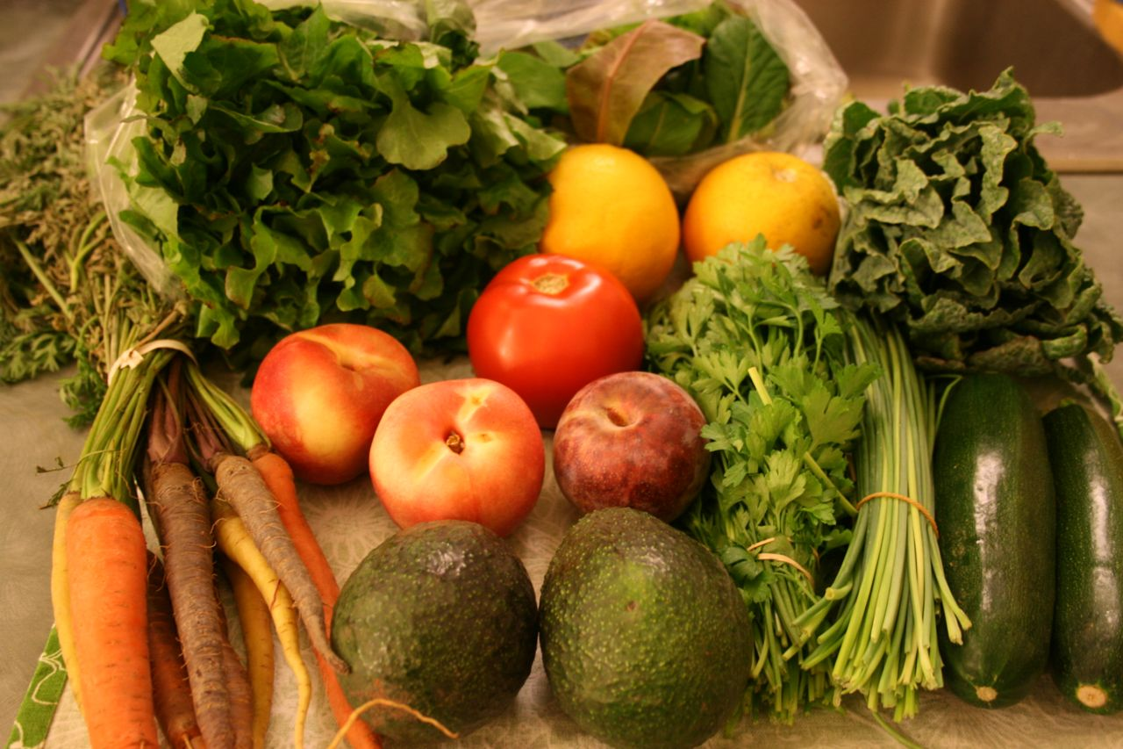
THE FUTURE OF FOOD – COMMUNITY SUPPORTED AGRICULTURE (CSA)
29
Notes:
Community Supported Agriculture or CSAs is a also great alternative for individuals and families to support local farmers. People who join a CSA receive a weekly or biweekly box of produce from a local farm. CSAs can be cheaper way of buying local produce than a farmers market. There is a large variety in the types of CSAs. Some CSAs deliver the box to your front door, but often CSAs involve a pickup for a neighborhood. Sometimes work sites sign up for a CSA delivery, some times CSA pick ups are at farmers markets.
The fruits and vegetables you see here are from a weekly box of fruits, vegetables, and herbs in a CSA box from the San Diego area. What fruits and vegetables do you see in the picture?

Slide 30
http://vimeo.com/1016506
WHERE DO I GET MY 5 FROM? “MEET ME AT FAIRFAX & 3RD”
Source: http://www.publicmattersgroup.com
30
Notes:
Some neighborhoods do not have grocery stores or convenience stores that stock fresh fruits and vegetables. These neighborhoods without access to healthy food are called “food deserts”. People who live in “food deserts” often have to travel for great distances to purchase healthy food for their families. Often, food deserts are in neighborhood that are already underserved.
South L.A. is a “food desert”: too few supermarkets and a lot of distance between them. This video is the true-to-life tale of an epic journey, two hours – by bus. It chronicles the extraordinary efforts undertaken by a student, Lae Schmidt, to get the quality and variety of fruits and vegetables she desires. Not content to leave conditions as they are, Lae sits down with her local Councilwoman to discuss what can be done to improve healthy food access in her community.

Slide 31
DISCUSSION QUESTIONS
Any clarifying questions about the video?
What did you think of the video?
Did the video give you any ideas about projects you would like to implement in your community?
What really stood out for you from the video?
31

Slide 32
Homework Options
conclusion
THANK YOU!
Questions?
Comments
1. Take a healthy recipe and make it with your family and/or friends while sharing with them what you learned in this session on Healthy Food Systems
2. Buy produce from a local farmers’ market. Take notes about your experiences and observations
32

