Slide 1
Section 2: Strategies
Supporting Health: Everyday in Every Way
Notes:
Overview: Welcome to our next session.

Slide 2
Agenda
Section 2: Supporting Health: Everyday in Every Way
Icebreaker/Review
Health Systems
Home and Neighborhoods
Workplace
Marketplace
Conclusion
Health Access
Health Access
Notes:
Overview: Brief review of agenda.

Slide 3
Ice Breaker
Sharing our Leadership Styles
What was your result and does it fit you?
What does your style look like at a party?
What does your style look like in a crisis or conflict?
Notes:
Overview: This is a fun, non-scientific activity to get participants thinking about their own leadership and communication styles, to get to know one another, and to begin to learn how they will work together as a team using the variety of natural strengths in the group.
Activity:
Before class print out the shape descriptions in the Ice Breaker section of the Digital Library.
Ask the participants to pick the first shape they are attracted to then get into groups with other participants who picked the same shape.
Read the description of each shape out loud to the entire group. You can find the descriptions in the Ice Breaker section of your Digital Library.
Then have the groups discuss the questions on the slide.
After about ten minutes mix up the groups so that they are in “mixed-shape” groups and have them discuss the same questions.
After about ten minutes bring the entire group back together and ask for a volunteers to talk about their observations.

Slide 4
Section 1 Review
What did we learn in Section 1?
Social Determinants
Health Equity
and Health Disparities
Community Improvement Project
Notes:
Overview: Time for a basic review. Also ask if there were any “aha” moments since the last time you met. If appropriate, have a very brief group discussion.

Slide 5
Section 2: Strategies
Learning Objectives:
Identify health determinants and how they affect health.
Identify changes that can be made in communities to improve health.
Notes:
Overview: Review the learning objectives.

Slide 6
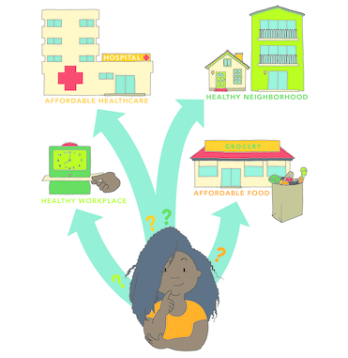
Health Determinants
Notes:
Overview: The participants “met” Ciara in their workbook homework. Direct participants to their workbook to quickly review her story on page 23.
Group Discussion: Could you relate with Ciara? What were some of the barriers she faces in making healthy decisions? What were some of the things that supported her making healthy decisions? Ask if any participants are willing to share some of the things that challenge or support their ability to make healthy decisions.

Slide 7
Health System
The Health Impact Pyramid
Notes:
Overview: The healthcare system is big and complex. There are many factors that impact how individuals, communities, and societies use the healthcare system. This is an opportunity to break down the health pyramid in laymen’s terms. The overall goal is to show that focusing efforts on upstream approaches such as community and policy changes are better models because they decrease the need for treatment by decreasing the incidence of chronic diseases.

Slide 8
Video CLip
Is Obamacare Working? The Affordable Care Act Five Years Later
Notes:
Overview: The Affordable Care Act (ACA) is a government policy that attempts to make our complex and expensive healthcare system more accessible and easier to manage for all Americans.
https://www.youtube.com/watch?v=wMuXcuudvCc

Slide 9
Break Time
Notes:
Facilitator Tip: Use this time for a break. Give participants a five to ten minute break depending on the needs of the group and the length of the meeting. Use the resources in the Digital Library to choose one stretch for your group.

Slide 10
Ciara’s Story
Notes:
Overview: Revisit Ciara and talk about the group’s answers about her health determinants in the workbook.

Slide 11
Activity
Instructions:
Fill in the boxes below with your answers.
Access to Healthcare
Access to Economic Opportunities
Access to Healthy Food
Notes:
Group Discussion: Ask for a few participants to share their answers.
Facilitator Tip: This was an activity in the reading assignment from last week. If they did not complete it let them know that you will revisit these workbook activities in class.

Slide 12
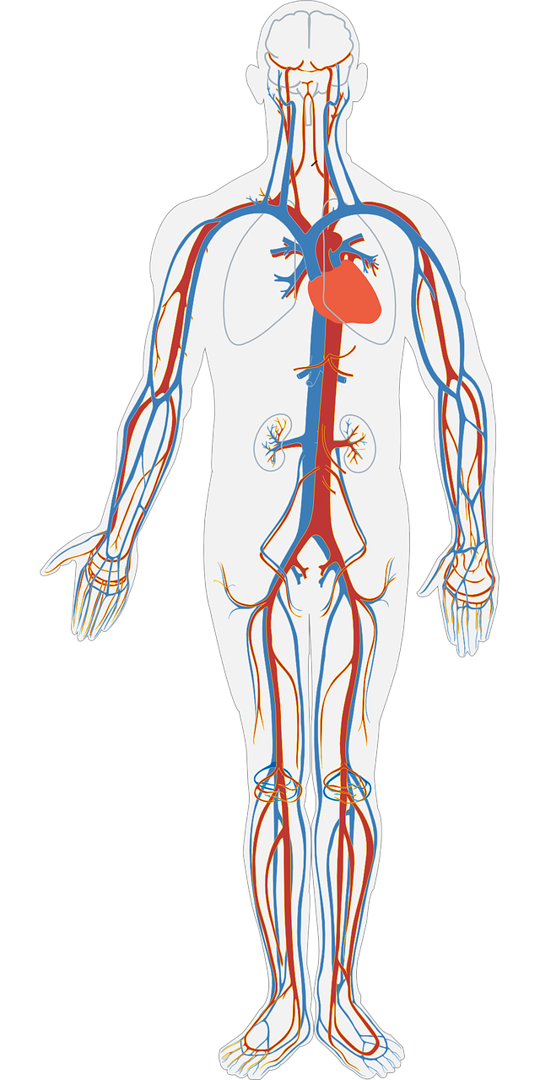
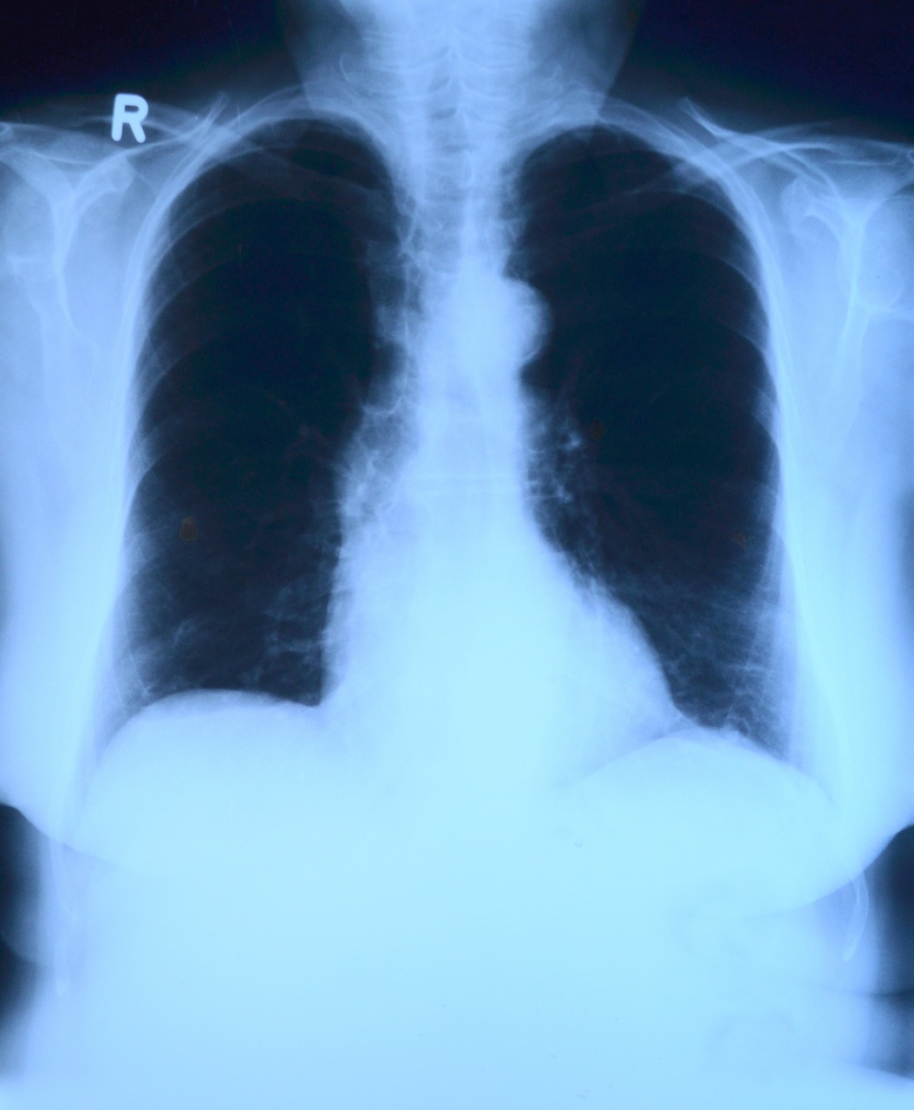
Health Determinant
Health System
Notes:
Overview: At this point the trainings will shift to strategies rather than a review of the reading. Help guide the group in thinking about their own neighborhood and keeping them at the community rather than individual level.
Group Discussion: Thinking about the SEM, what are some community level strategies for increasing community access to healthcare?
Some answers may include bringing screenings into the community, putting together a list of preventive classes and services that are already in the neighborhood, and pairing people together (in particular seniors and those with disabilities, a chronic health issue(s), or an emerging health issue) to attend doctor appointments.
Facilitator Tip: This may be an opportunity to have a quest speaker from a local health clinic to talk about how to enroll people in their neighborhoods in ACA and offer links to free services. Also a good opportunity to briefly mention the concept of patient advocacy (individuals taking control of how they receive healthcare services) and remind people about further information in the Deep Dive.

Slide 13
Podcast
Can Health be Cured of Racial Bias?
Notes:
Overview: This connects access to healthcare with oppression and discrimination as a social determinant.
http://www.npr.org/sections/health-shots/2015/08/20/ 432872330/can-health-care-be-cured-of-racial-bias?sc=tw

Slide 14
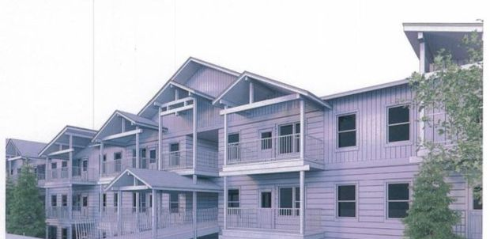
Health determinants
Home and Neighborhood
Notes:
Group Discussion: Thinking about the SEM, what are some community level strategies for increasing health in homes and neighborhoods?
Some possible answers include limiting exposure to mold and lead, smoke free Multiunit Housing (MUH), parks and faith organizations, and exposure to pollution through industry in neighborhood.
Facilitator Tip: The next slides include group discussion. Assess how much time you have, and adjust the discussion for each slide accordingly.
Apartment picture from: http://missoulian.com/news/local/new--unit-apartment-planned-for-former-missoula-trailer-park/article_dc291641-d6e5-5454-9e7a-1909f2cbe61c.html

Slide 15
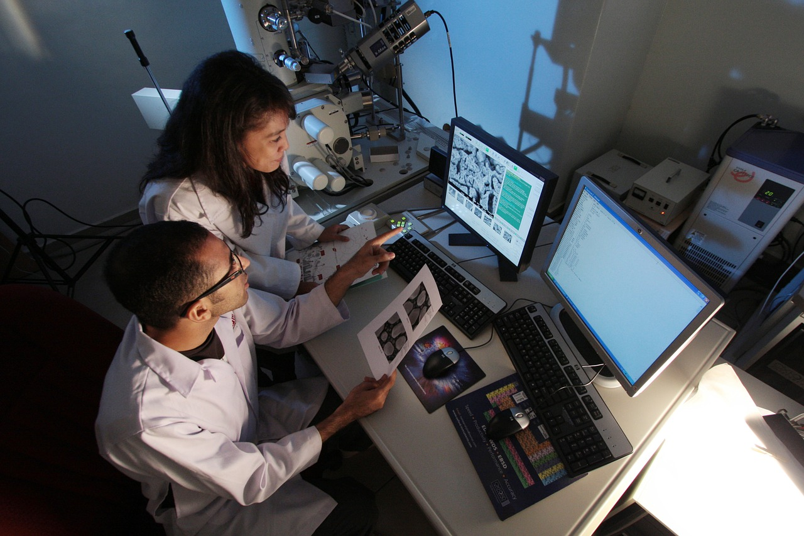
Health Determinants
WorkPlace
Notes:
Group Discussion: Thinking about the SEM, what are some community level strategies for increasing health through workplaces?
Some possible answers include enforcement of safety standards and provision of proper protective equipment, walking meetings, providing healthy snacks and a water dispenser, and employee wellness programs.

Slide 16
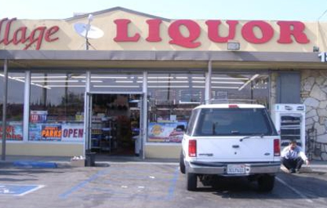
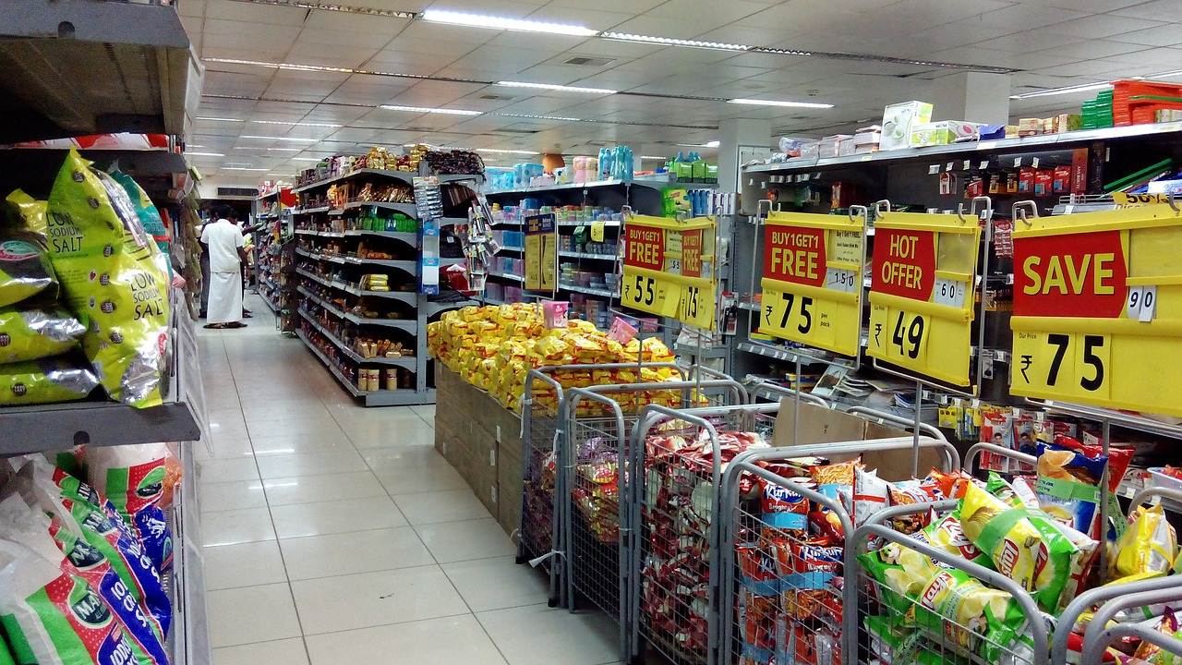
Health Determinant
Marketplace
Notes:
Group Discussion: Thinking about the SEM, what are some community level strategies for increasing health through the marketplace?
Some possible answers include bringing fresh food to small markets in food deserts, curbing advertisements of unhealthy food, alcohol, and cigarettes, enforcement of not selling tobacco and alcohol to minors, and tobacco retail licensing.

Slide 17
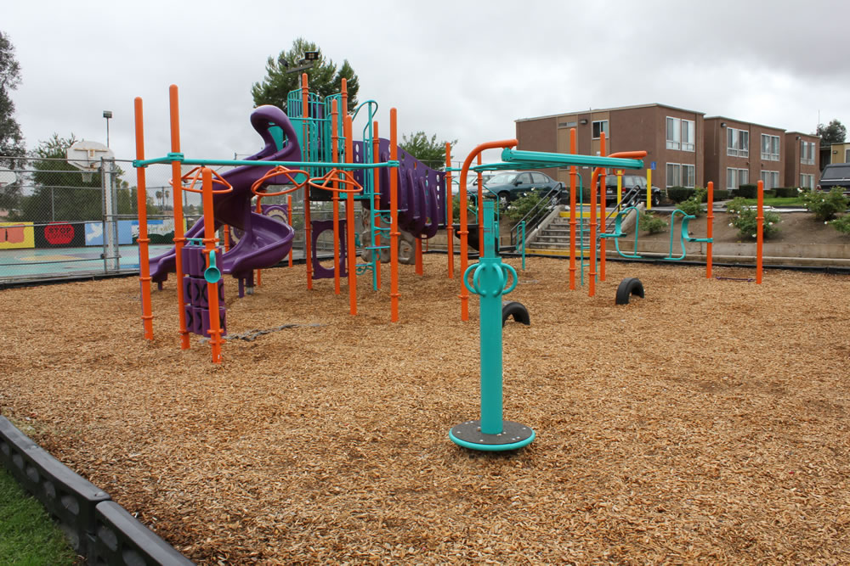
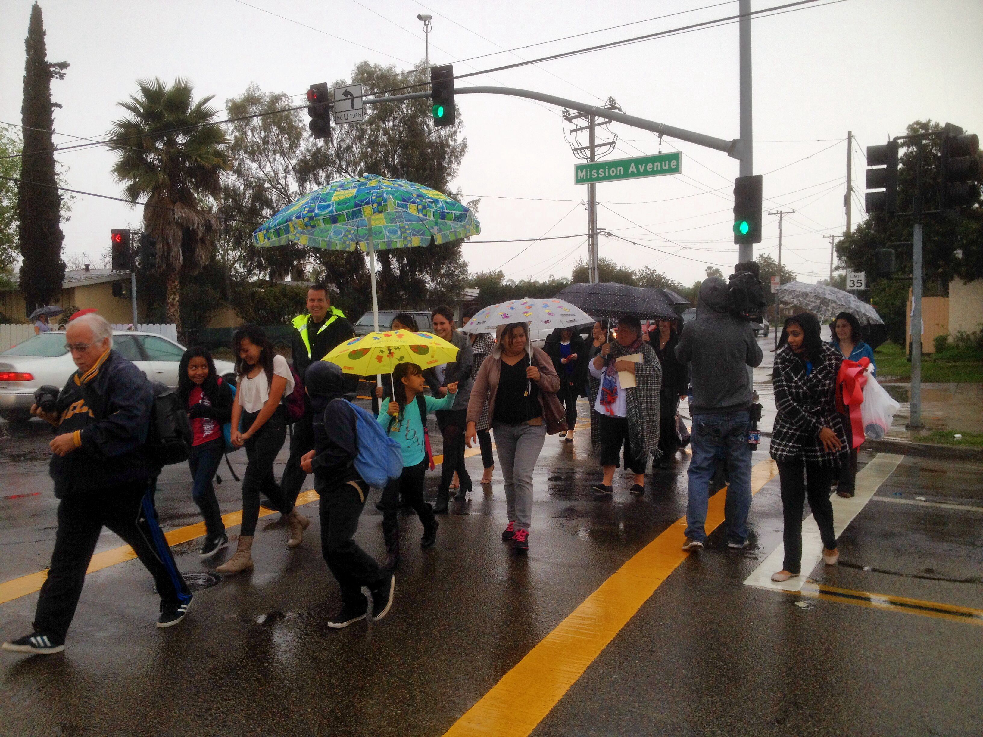
Healthy Benefits
PLACES THAT HAVE DEVELOPED AN ACTIVITY-FRIENDLY ENVIRONMENT
WITH ACCESS TO FRESH, HEALTHY FOODS WILL HAVE HEALTHIER PEOPLE
Notes:
Overview: Communities that support and encourage healthy behaviors including exercise, eating right, and not smoking help residents get healthy and stay healthy.

Slide 18
Smoke-Free Policy at ‘PJAM’
Notes:
Overview: This is a resident led success story that got tobacco out of this multiunit housing complex.
Group Discussion: What health determinants did this RLA address? What was the solution? How do you imagine the group participants made decisions about what strategy to use? What challenges did you think they faced?

Slide 19
Strategies to prevent Tobacco use
Breathing Easier At Home
Notes:
Overview: Tobacco prevention efforts aimed at community and policy change have decreased the rate of smoking by about 50%. Even so, smoking is still the number one cause of preventable death. This video series shows lots of examples of community level changes that RLAs can think about for their own communities.
https://www.youtube.com/watch?list=PLxdDQiAI50j9 dvC6FgzlIi7dHbevdQz86&v=Cfcv6QRss_c

Slide 20
Conclusion
Homework
Read Section 2.2 Land Use
Scan the Deep Dive to get an idea of additional information available to you
Questions?
Comments?
Concerns?
Notes:
Overview: Answer any lingering questions and/or take the time to address issues that you think may remain unclear. Remind participants that the sections are an overview and there is more information about each topic in the Deep Dive.

Slide 21
"This curriculum was supported by the Cooperative Agreement Number DP005528-01, funded by the Centers for Disease Control and Prevention through the County of San Diego, Health and Human Services Agency. Its contents are solely the responsibility of the authors and do not necessarily represent the official views of the Centers for Disease Control and Prevention or the Department of Health and Human Services."

