Slide 1
SECTION 3: Taking Action
CIP Planning and Implementation
Notes:
Overview: Welcome to our next session. Tonight we begin to plan our Community Improvement Project (CIP)!

Slide 2
Agenda
Section 3.2: CIP Planning & Implementation
Icebreaker/Review
SMART Objectives
Community Analysis
SWOT Analysis
CIP Tools
Conclusion
Notes:
Overview: Brief review of agenda.

Slide 3
Section 3: Taking Action
Learning Objectives:
Understand civic engagement and how to influence the decision-making process.
Create an implementation plan for a Community Improvement Project (CIP).
Notes:
Overview: Tonight is all about putting what the group has learned into practice. This is a planning session. The group will be working together to plan and implement their CIP. Use the planning tools and make sure everyone in the group has a copy of the completed plan. Having this in hand helps to keep the project on track and keeps the group clear on their goals and responsibilities.
Activity: This entire session is a planning activity. It will require good facilitation skills to keep everyone on track. Move through the activities and tables in order and give the group time to come to a consensus before moving to the next task.
Facilitator Tip: Keep an eye out for counterproductive behaviors like individual group members taking over, lack of engagement with the group, or participants not being heard because it will decrease buy in from the participants and potentially lead to lack of commitment to the project. This is a big project that requires a lot of planning. Think about splitting this process over two sessions.

Slide 4
Ice Breaker
Notes:
Overview: There is a lot of planning and group process tonight so it might be nice to do something quiet and centering. One idea is to bring oranges for everyone and do Thich Nhat Hanh’s Orange Meditation (http://www.chetday.com/mindfuleating.htm).

Slide 5
3.1 Civic Engagement Review
What did we learn About Civic Engagement?
People are experts in their own lives
Meets the needs expressed by the residents and build their capacity and power
Is focused on improving the community at large
Notes:
Overview: Review from last week and ask the group to keep what they learned in mind to apply to their CIP.

Slide 6
3.1 Civic Engagement Review
Win Win?
Starting in our neighborhood
Is it good for most of the people in the neighborhood?
Will most people support the change?
Will we have enough people to help get the project done?
Is it a community level change?
Will we be able to see the impact of the change soon?
Notes:
Overview: Choosing a CIP is no easy task! We will use everyone’s ideas that they brought from their SEM Activities and reflection questions to choose a CIP as a group using the criteria above. It is a good idea to start with a neighborhood level, win-win project in order to build teamwork among the group and build a foundation for additional CIPs or more complex improvements later.
Activity: Before class, hang up several pieces of flip chart paper around the room. At least two per RLA member. Instruct the participants to write one CIP idea per piece of paper. Everyone should have brought at least one idea per their homework from the last session. After every project idea is written, combine any ideas that are the same or very similar and discuss them as a group using the criteria above. Then have the group put the projects in the order that they would like to complete them. For example, number one will be the first project they work on, number two is the second project, and so on.

Slide 7
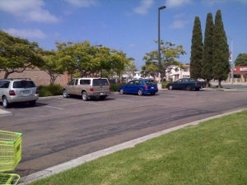
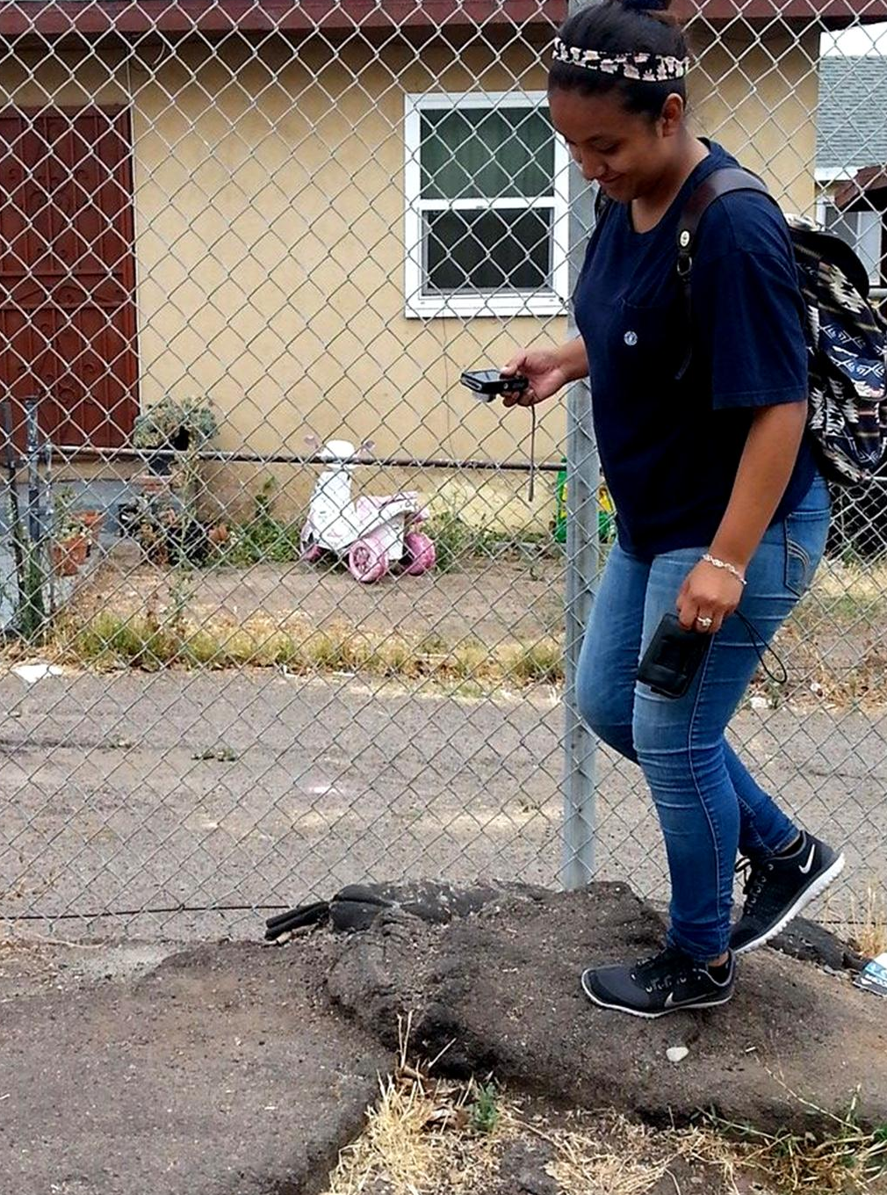
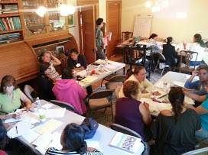
COMMUNITY ANALYSIS
Notes:
Overview: This is a vital step to planning. Do not skip it because you might miss very important information that will help you in implementing your CIP.

Slide 8
Break Time
Notes:
Facilitator Tip: Use this time for a break. Give participants a five to ten minute break depending on the needs of the group and the length of the meeting. Use the resources in the Digital Library to choose one stretch for your group.

Slide 9
SWOT Analysis
Strengths
Weaknesses
Opportunities
Threats
Notes:
Activity: Put up a piece of flip chart paper with each section of the SWOT (Strengths, Weaknesses, Opportunities and Threats) and the description including whether it is internal or external. Have the participants write their ideas about each one on the papers. Over the next four slides you will do the following for each section of the SWOT: ask four participants to present each of one of the sections to the group. Ask if there is anything missing and add the missing items the group comes up with.

Slide 10
SWOT ANALYSIS
Strengths
Advantages
Achievements
Notes:
Overview: Strengths help you achieve your goal. They come from within the group and community.

Slide 11
SWOT ANALYSIS
Weaknesses
Vulnerabilities
Missing skills or knowledge
Notes:
Overview: Weaknesses also come from within your group and community. Identifying weaknesses is important so that you can address them and/or find a way to compensate for them.

Slide 12
SWOT ANALYSIS
Opportunities
Resources
Contact person(s)
Notes:
Overview: Opportunities are outside of the group. They help the project succeed.

Slide 13
SWOT ANALYSIS
Threats
Obstacles
Potential Problems/Risk
Notes:
Overview: Threats also come from outside of the group. Anticipating potential threats to the project will help you strategize ways around or through them.

Slide 14
Community Improvement Project
CIP Action Plan
Notes:
Overview: Having a clear action plan keeps everyone on track and clear about the tasks for which they are responsible.
Activity: Work with the group to fill in the action plan on page 79. Each person should also fill out the action plan and the SWOT in their own workbook to have a guide and example for later projects.

Slide 15
Conclusion
Homework
Review your planning tools again
Think about how you will contribute to the CIP.
Questions?
Comments?
Concerns?
Notes:
Overview: Great job! That was a lot of work! Review the homework for next week. Especially thinking about how you will contribute to the CIP.

Slide 16
"This curriculum was supported by the Cooperative Agreement Number DP005528-01, funded by the Centers for Disease Control and Prevention through the County of San Diego, Health and Human Services Agency. Its contents are solely the responsibility of the authors and do not necessarily represent the official views of the Centers for Disease Control and Prevention or the Department of Health and Human Services."

