Slide 1
القسم الثالث: التحرك العملي
المشاركة المدنية
Notes:
Overview: Welcome to the next session!

Slide 2
جدول الأعمال
قسم 3.1: المشاركة المدنية
تهيئة/مراجعة
ما معنى المشاركة المدنية؟
مستويات الحكومة
الحكومة المحلية
التفاعل مع القادة
التنظيم الجماعي
الخاتمة
Notes:
Overview: Brief review of agenda.
Image from: http://www.wcpss.net/carrollms

Slide 3
القسم الثالث: التحرك العملي
الأهداف التعليمية:
فهم المشاركة المدنية وكيفية التأثير على عملية صنع القرار.
إعداد خطة تنفيذ لأحد مشروعات تحسين المجتمع (CIP).
Notes:
Overview: Review the learning objectives.

Slide 4
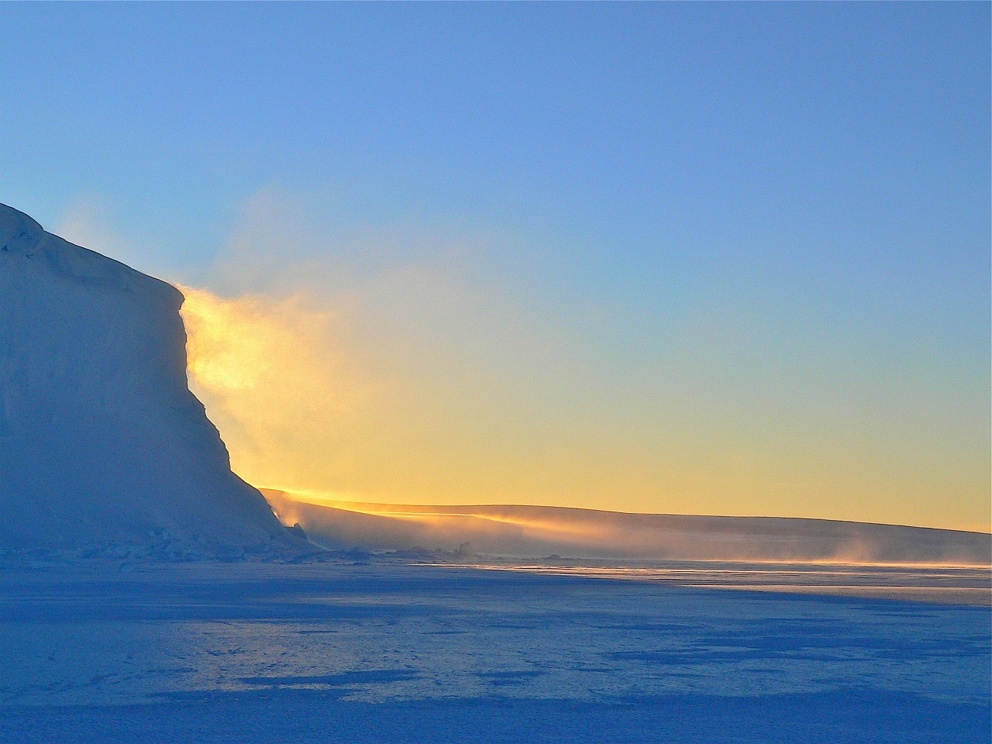
تهيئة
Notes:
Overview: Use the resources in the Digital Library to choose an icebreaker activity for your group.

Slide 5
مراجعة قسم الأنظمة الغذائية
ماذا تعلمنا من الأنظمة الغذائية؟
السياسات الغذائية
الأعمال التجارية الضخمة
البيئات الغذائية
التكاليف الصحية
تطوير نظام غذائي صحي
Notes:
Overview: Revisit the strategies that we have learned about:
Food Systems – Starting a community garden
Connect those to what we learned about:
Land Use – Creating a bike lane
Active Transportation – Getting a sidewalk repaired to improve walkability
Supporting Health – Promoting smoke-free public spaces
Group Discussion: In what ways do the strategies in Section Two intersect?
Ask people if they have any early thoughts about a possible Community Improvement Project (CIP). What made them decide to go in that direction? Tell us about some of the ideas you have on the Social-Ecological Model (SEM) Activities you have been doing in your workbook.

Slide 6
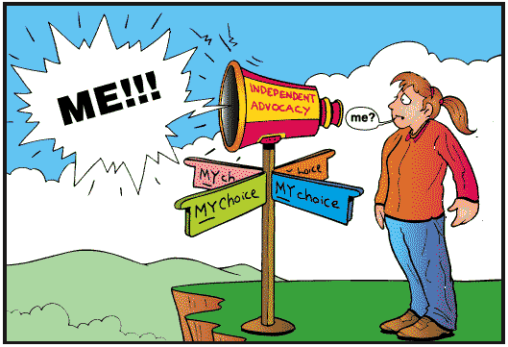
المشاركة المدنية
Notes:
Overview: Civic engagement is defined as working to make a difference in the civic life of our communities by promoting the quality of life in communities through both political and non-political processes.
Group Discussion: What does civic engagement mean to you? Possible answers are voting, attending public hearings, and signing a petition for or against something that affects your neighborhood or state.
Source: Civic Responsibility and Higher Education, edited by Thomas Ehrlich, published by Oryx Press, 2000.

Slide 7
مقطع فيديو
شرح حكومة الولايات المتحدة في خمس دقائق
Notes:
Overview: The “Three Branches of Government” explained as the “Three Brothers of Government.”
https://www.youtube.com/watch?v=buQQuyWFtZU

Slide 8
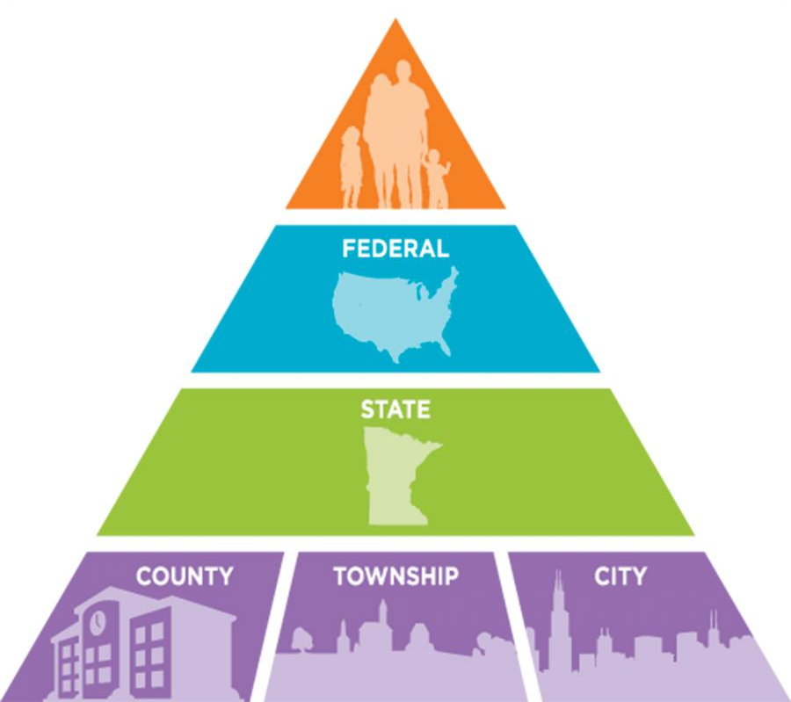
مستويات الحكومة
Notes:
Overview: Discuss the broad roles of policy makers in larger society.
Group Discussion: Quiz the group on the titles at each level:
Federal – President, Congresswoman, or Secretary of Agriculture
State – Governor, Assemblyman, or State Attorney General
County – Supervisor, Chief Administrative Officer or Sheriff
City – Mayor, Councilmember, or Police Chief
Image from: http://education.mnhs.org/northern-lights/learning-resources/chapter-7-minnesotas-newcomers/levels-government

Slide 9
مقاطعة سان دييغو
البلديات والأمم القبلية
هناك 18 بلدية، أو مدينة مدرجة و18 محمية للسكان الأمريكيين الأصليين في مقاطعة سان دييغو
Notes:
Overview: These are all governed by their own elected officials within the larger county, state, and federal governments.
Source: www.sandag.org

Slide 10
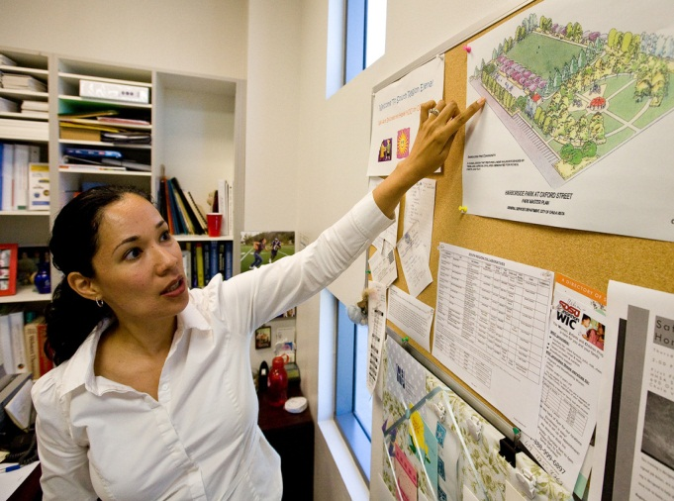
معظم مشاريع تحسين المجتمع تبدأ بالحكومة المحلية
هيئة مشرفي المقاطعة
العمدة
موظفو المقاطعة
أعضاء اللجنة
أعضاء مجلس المدنية
موظفي البلدية
مخططو المدينة
Notes:
Overview: Most CIPs start at the local level of government. Community groups can make significant health impacts and improvements at the local level.
Group Discussion: Discuss why local level change is effective. A couple of points to cover are access to local decision makers and the time it takes for some projects to come to fruition, even local projects.

Slide 11
كيفية التفاعل مع صناع القرار
يجب أن تتحلى بما يلي:
الاحترافية
الجاهزية
الصبر
الدقة
القدرة على الإقناع
الحماسة
احترام الآخرين
Notes:
Overview: Local leaders are important change-makers. Approaching them with your CIP and the issues it addresses is a great start to making change. The following exercise will help you prepare to have a quick and direct conversation with them.
Suggested Activity: Break the group into pairs and have them role-play a meeting with an elected official suggesting a community improvement strategy in their neighborhood. Give each person 10-15 minutes. Imagine you only have 10 minutes with the elected official:
Introduction (2 minutes)
State the issue (3 minutes)
Propose the solution (3 minutes)
Ask for support (2 minutes)
Ask participants to share how it went with the larger group.
Facilitator Tip: As a facilitator this will give you insight on the participants’ attitudes toward working with government and any unspoken fears they may have. Note that this activity takes at least a half an hour. Depending on your group you may want to skip it, however it gives very good practice on how to present a CIP and the issue it addresses. If you do not feel like you have time to do it in class you can assign it as homework.

Slide 12
استراحة
Notes:
Facilitator Tip: Use this time for a break. Give participants a five to ten minute break depending on the needs of the group and the length of the meeting. Use the resources in the Digital Library to choose one stretch for your group.

Slide 13
مقطع فيديو
مدرسة ليك فيو الابتدائية
Notes:
Overview: Lakeview parents make a difference
https://www.youtube.com/watch?v=saUjx_WTvMY

Slide 14
التنظيم المجتمعي
التنظيم المدني
إنشاء منتدى حواري للقادة من السكان لتعزيز المصالح الاجتماعية والبنية المجتمعية
استخدام القادة من السكان لقنوات رسمية والمشاركة مع الحكومة لتشجيع التغيير والحصول على الخدمات
Notes:
Overview: This is a snapshot of Civic Organizing. You can familiarize yourself more with different types of organizing including the three presented here by looking at.
Source: http://www.sagepub.com/ sites/default/files/upm-binaries/ 24165_Chapter1.pdf

Slide 15
التنظيم المجتمعي
بناء المجتمع
إقامة شراكات بين:
السكان
الحكومة
الأعمال التجارية
الشركاء المهتمين
عامة ما يكون للمجهود المبذول قائدًا معروفًا أو منسق يقود المجموعة لإنجاز خطة رفيعة المستوى وتحديد الأولويات المجتمعية
Notes:
Overview: This is a snapshot of Community Building
Source: http://www.sagepub.com/ sites/default/files/upm-binaries/ 24165_Chapter1.pdf

Slide 16
التنظيم المجتمعي
بناء التوافق
يعتمد حشد الشركاء على المصلحة الشخصية المتبادلة لتحقيق أهداف ينتفع منها جميع المشاركين
يبني شراكات تقوم على القيادة المشتركة والترابط الاجتماعي، ولكن عادة ما يكون لها منظم مُعرّف.
Notes:
Overview: This is a snapshot of Consensus Building. Think about consensus building as we go through the next slides on leadership and creating community change.
Source: http://www.sagepub.com/ sites/default/files/upm-binaries/ 24165_Chapter1.pdf

Slide 17
القيادة
سبع خطوات في تنظيم التوافق
الخطوة الأولى: عيّن مجموعة قادة المجتمع
الخطوة الثانية: قم ببناء العلاقات
الخطوة الثالثة: اجري تحليلاً للمجتمع
الخطوة الرابعة: صمم ونفذ مشاريع مفيدة لكل الأطراف
الخطوة الخامسة: شارك المعلومات
الخطوة السادسة: طوّر الستراتيجيات ونفّذ خطة عمل
الخطوة السابعة: أنشيء قيادة داخل المجموعة
Notes:
Overview: These are the steps in theory to leadership using a consensus building as a community-organizing model.

Slide 18
القيادة
الخطوة الأولى: عين مجموعة قادة المجتمع
Notes:
Overview: Have a general discussion on what leadership means, remember the video from our first night about everyday leadership. Leadership is a verb not a title! People have different ways of leading and different strengths, each of them are valuable. A team that draws from and utilizes the full range of different strengths and skills of their membership will generally be stronger than the one that relies on one person to follow.
Group discussion: This is what is happening right now, you are all leaders in your own way. Through this training you have already begun the process! Ask them to share how their perception of themselves as leaders has changed or strengthened throughout the training so far.
Facilitator Tip: This is a great time to acknowledge the different strengths of each group member. Take some time to think about each participant and highlight something great that you have noticed about them and share it in front of the group. Be sure to highlight every group member.

Slide 19
القيادة
الخطوة الثانية: قم ببناء العلاقات
Notes:
Overview: The group has read these steps in theory. Guide this section to be practical in order for them to see how they can apply these steps during their CIP process.

Slide 20
القيادة
الخطوة الثالثة: أجري تحليلاً للمجتمع
Notes:
Overview: Talk about the community assessment tools available to them (there are some tools already identified in this guide). Also talk about the value of a SWOT analysis, which they will do during the CIP planning process. The SWOT analysis on page 74 identifies strengths and weaknesses within the group and opportunities and threats within the larger environment.

Slide 21
القيادة
الخطوة الرابعة: صمّم ونفذ مشاريع مفيدة لكل الأطراف
Notes:
Overview: Define a win-win as a situation where everyone benefits. Describe an example of a CIP that was a win-win and name the stakeholders involved.
Group Discussion: Ask the participants if they have already identified any strategies or have any CIP ideas that could be a win-win.

Slide 22
القيادة
الخطوة الخامسة: شارك المعلومات
Notes:
Overview: Share information about the project in ALL manners available. Social media is cheap, but it is only one way. Do not discount the “old school” methods of press releases, flyers, phone calls, and knocking on people’s doors for a neighborly chat! Think about everyone you need to reach and what methods of communication they use.
Group Discussion: Identify those within your RLA that have a strength and interest in social media, writing, and/or designing newsletters and flyers.

Slide 23
القيادة
الخطوة السادسة: طور استراتيجيات ونفذ خطة عمل
Notes:
Overview: Having a well thought out plan keeps you on track and brings clarity to the goal.

Slide 24
القيادة
الخطوة السابعة: أنشيء قيادة داخل المجموعة
Notes:
Overview: Build on the strengths and interests of each individual in the group to assign tasks. This is an on-going process. Life happens and people will ebb and flow within the RLA.

Slide 25
النشاط
التعليمات:
اكتب اسمك بجانب الدور والمسؤولية الأنسب لك
اكتب أسماء زملاءك بجانب الدور والمسؤولية الأنسب لهم
Notes:
Overview: Everyone in this group has leadership skills. Everyone has strengths that contribute to a successful CIP. Combining them and using them effectively promotes success.
Activity: Create a list of roles and responsibilities and write each one on a piece of flip chart paper on the wall. Have the group write their name on the different roles they think they can help with and/or would be best at. Then have them go around again and have them write their cohorts names on the roles and responsibilities they think other group members would be good at. Sometimes others see talents in someone else that they do not see in themselves.

Slide 26
مقطع فيديو
التغيير في الأفق
Notes:
Overview: Community advocates in the heavily industrial city of Richmond, California, successfully worked to improve local air quality by documenting the effects of diesel truck traffic in residential neighborhoods and mapping new routes for the polluting vehicles.
https://www.youtube.com/watch?v=AH2Q1vOMsBM

Slide 27
قصة باولو وجوليا
مشاريع مفيدة لكل الأطراف
Notes:
Overview: Refer the group to Paulo’s story in the workbook.
Group Discussion: Did anyone see himself or herself in Paulo’s story? If so, why?

Slide 28
قصة جوليا
متعة طرح الأسئلة
Notes:
Overview: There are a few important things to remember about this process:
Play to your individual strengths and the strengths of the rest of your group.
Learn by getting involved and asking questions. You do not have to understand the entire process and know all of the players before you start.
Have patience. This is a learning process and like any other skill you have to practice.
Image from: http://kevinlhagan.com/where-are-you-looking/

Slide 29
الخاتمة
الواجب المنزلي
قم بتعبئة ورقة تدريبات الأسباب الأصلية ليتم جمعها في اللقاء القادم.
قم بمراجعة جميع أنشطة المشروعات الصغيرة والمتوسطة والأسئلة الخاصة بها وتحضير فكرة واحدة على الأقل لأحد مشروعات تحسين المجتمع لمناقشتها في اللقاء القادم
قم بقراءة القسم 3.2 حول تخطيط وتنفيذ مشاريع تحسين المجتمع والقسم 4 حول التقييم.
*يرجى عدم القيام بواجب الأنشطة!*
الأسئلة؟
التعليقات؟
المخاوف؟
Notes:
Overview: Next week we will begin planning our CIP! We want to get ideas from everyone and we know everyone already has a lot of great ideas in their SEM Activities and reflection questions. Please bring your favorite ideas to the next session and get ready to practice your consensus building skills.

Slide 30
"هذا المنهج حاصل على دعم الاتفاقية التعاونية رقم DP005528-01، وتم تمويله من قِبل مراكز مكافحة الأمراض والوقاية منها، من خلال هيئة الخدمات الصحية والإنسانية في مقاطعة سان دييغو. ويتحمل المؤلفون المسؤولية كاملة عن محتوياته، والتي لا تعبر بالضرورة عن الآراء الرسمية لمراكز مكافحة الأمراض والوقاية منها أو إدارة الخدمات الصحية والإنسانية".

